Slide 1
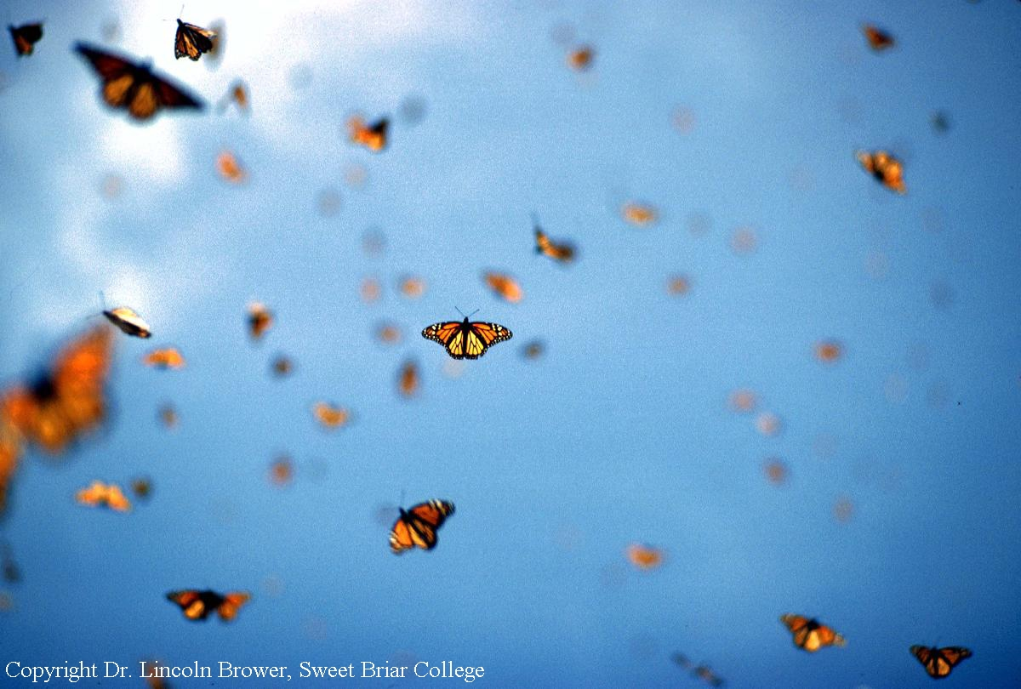
Using math to save monarch butterflies!
Girls Math & Science Day 2018

Slide 2

The monarch’s annual cycle
Spring Migration & Breeding
Summer Breeding

Slide 3
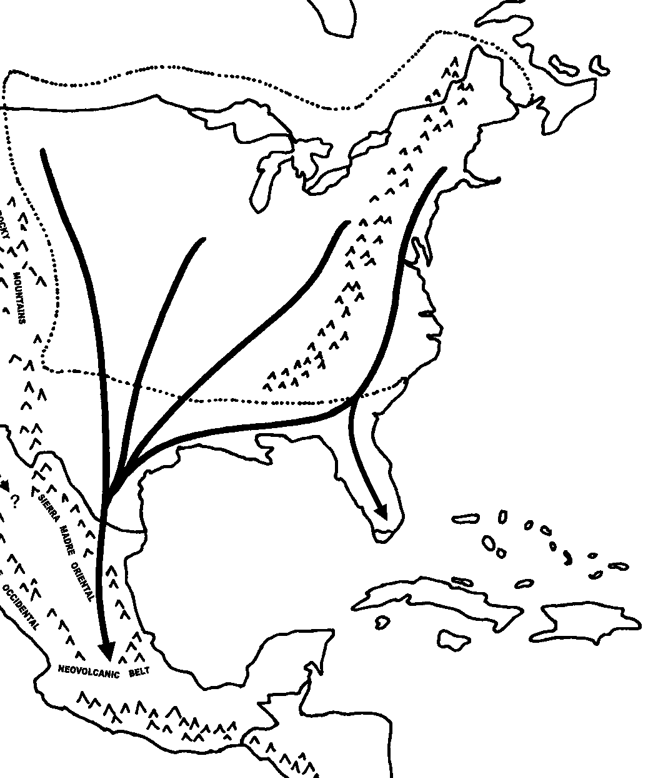
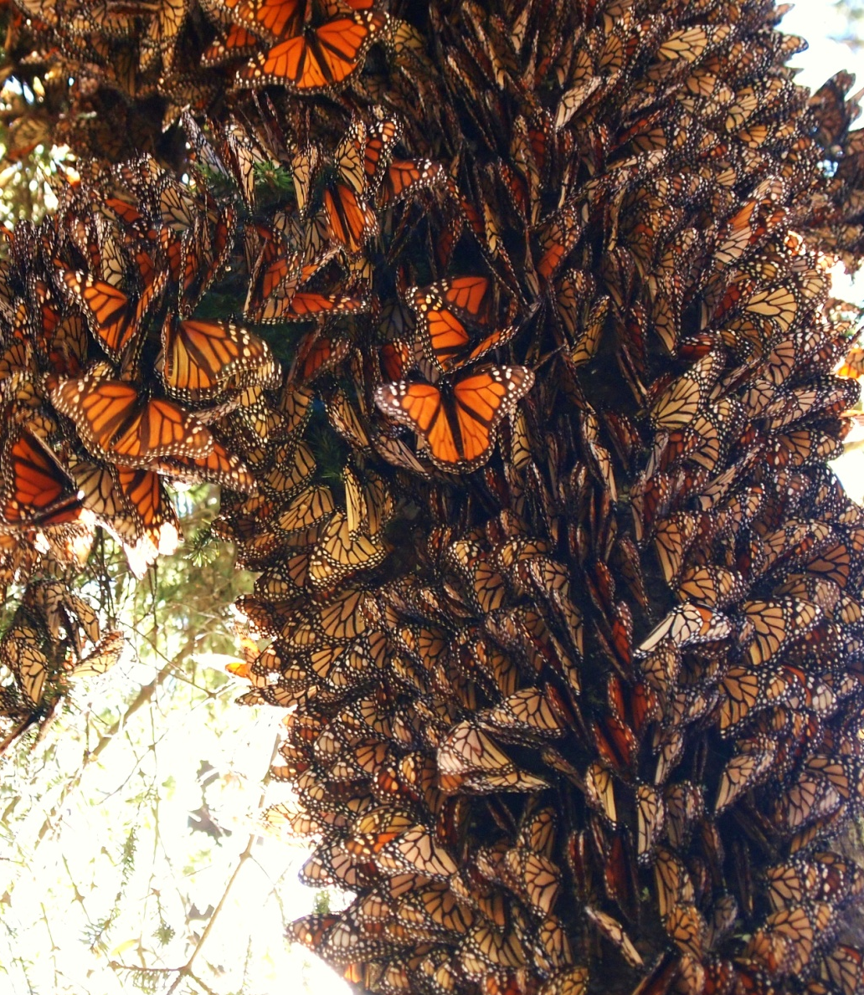
The monarch’s annual cycle
Fall Migration
Notes:
2,500+ mile journey; reproductive diapause

Slide 4

Monarch population decline

Slide 5
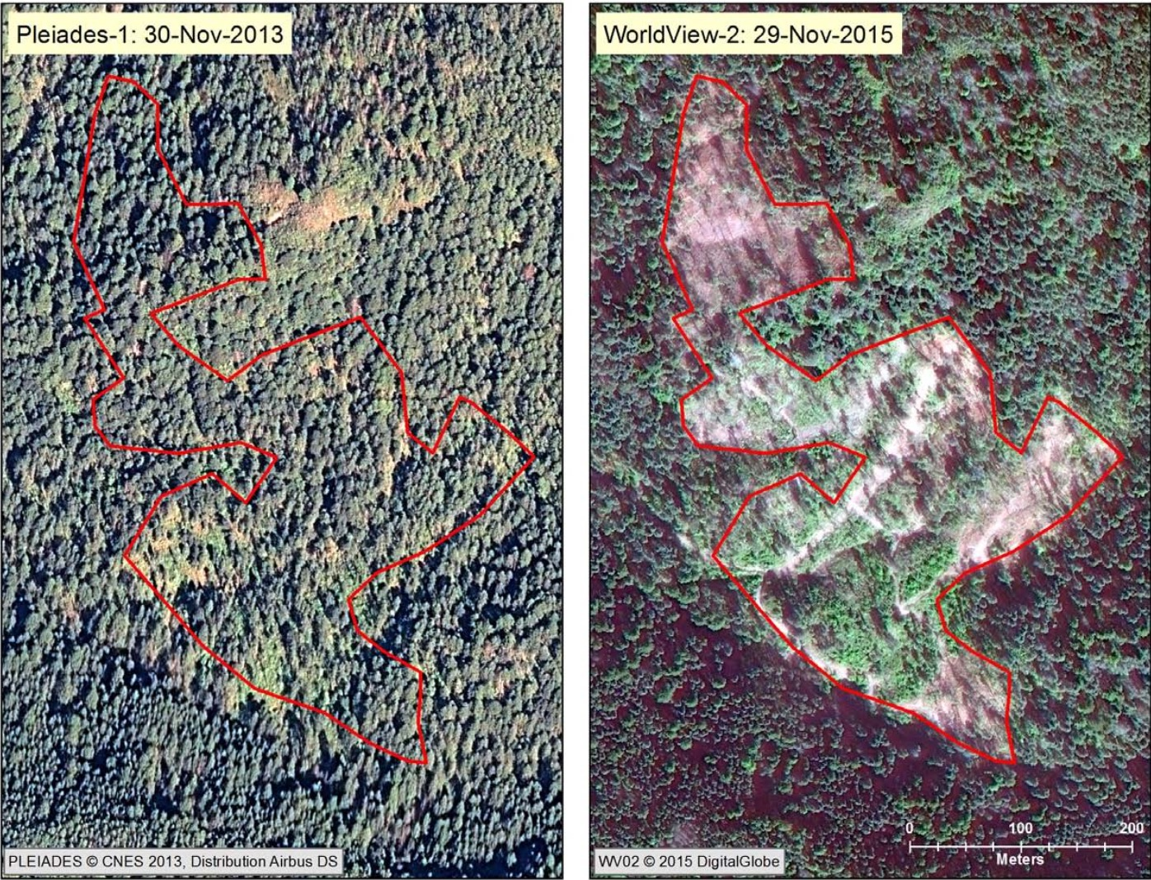

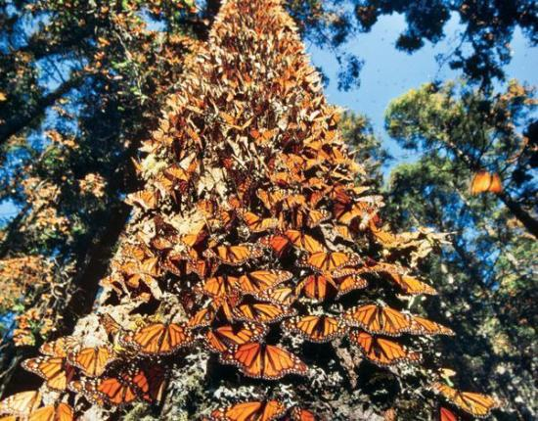
Why are monarchs declining?
Area in Mexico: 2013
Area in Mexico: 2015
Logging of winter habitat

Slide 6
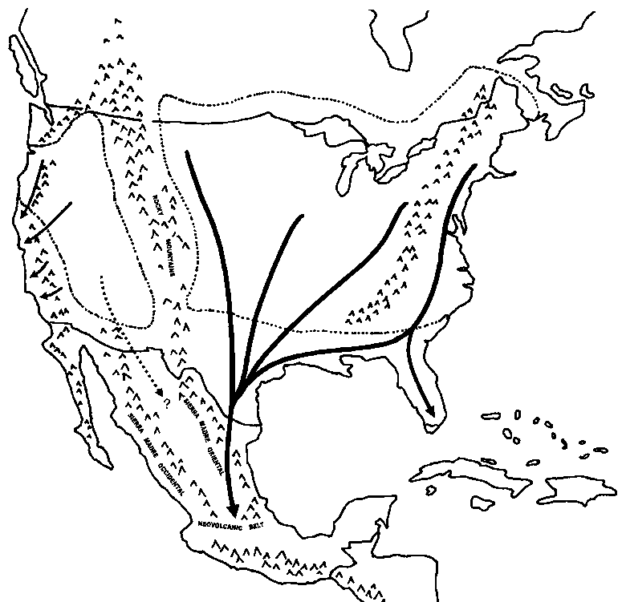
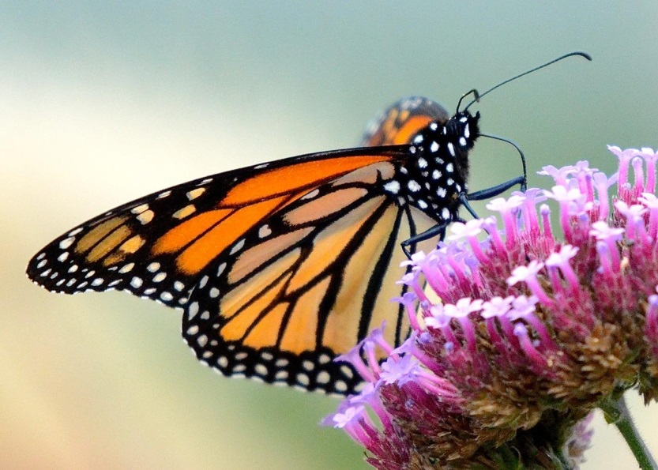
Why are monarchs declining?
Loss of nectar plants
FALL

Slide 7
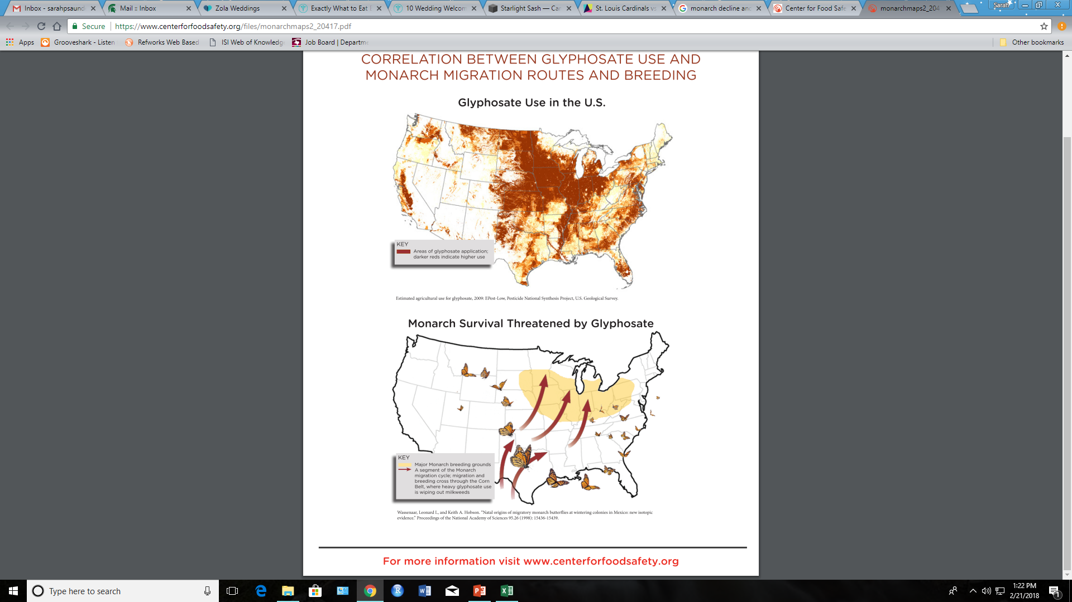
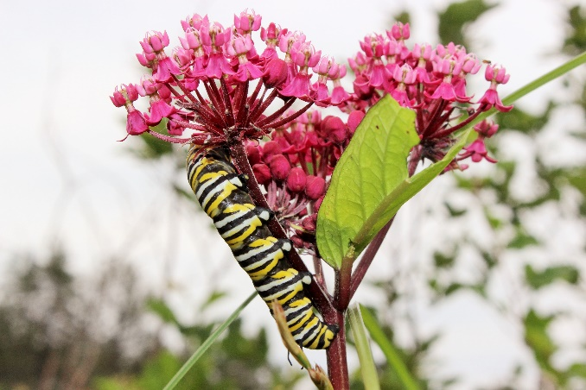
Why are monarchs declining?
Milkweed loss

Slide 8
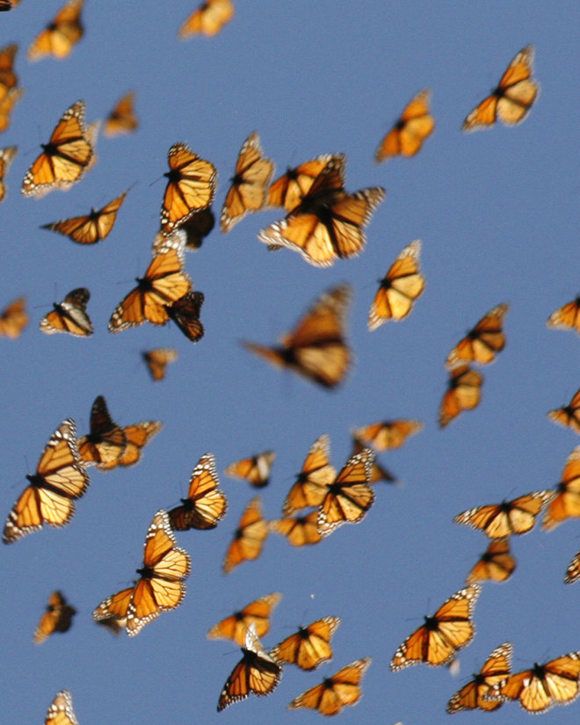
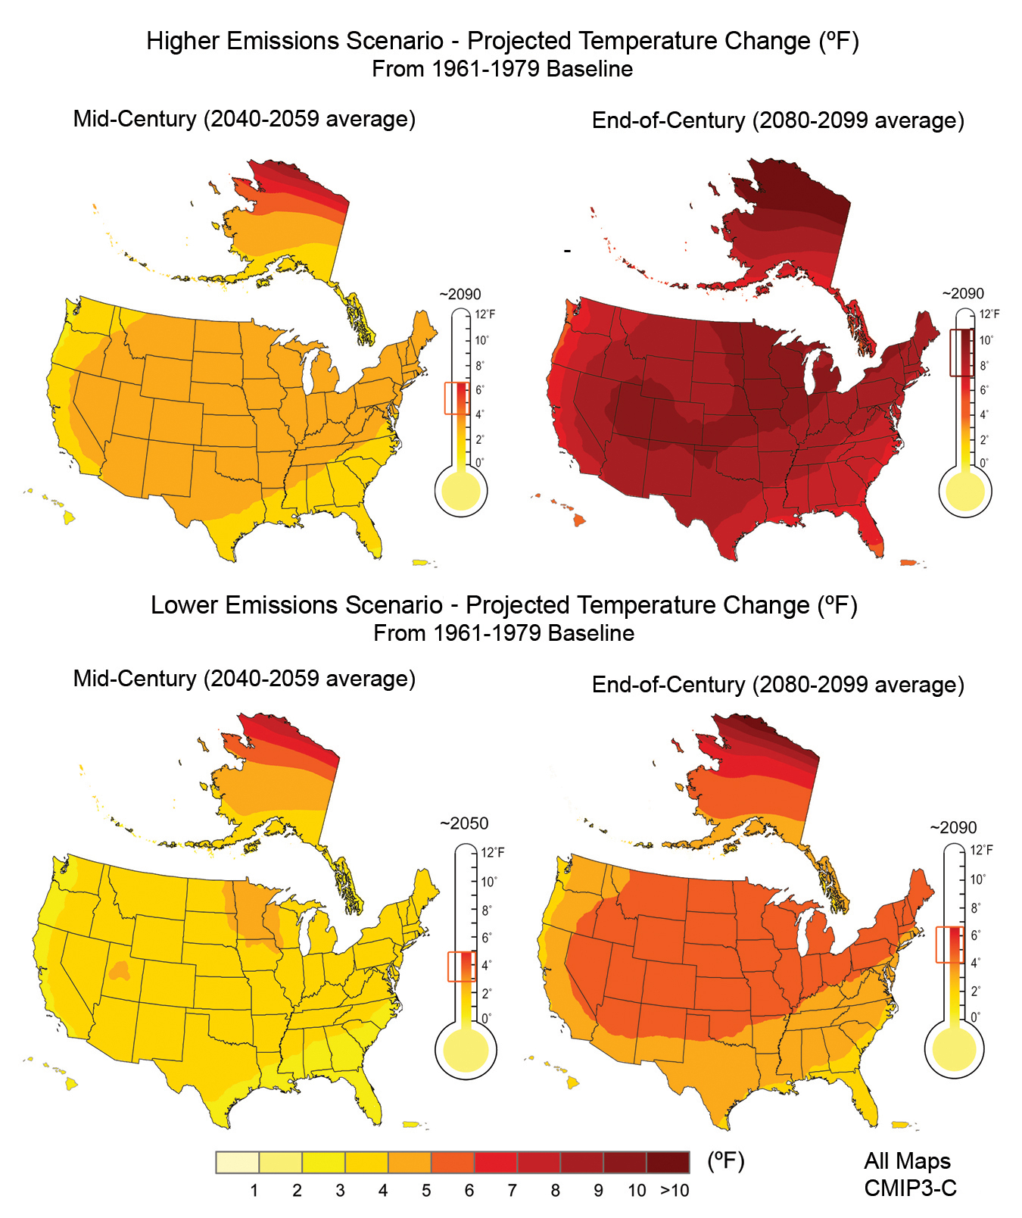
Why are monarchs declining?
Climate change

Slide 9
How can we use math to save monarchs?
Let’s use a model!

Slide 10
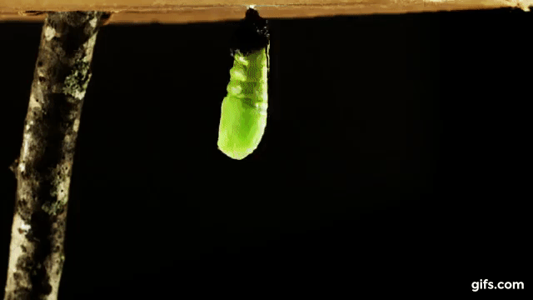
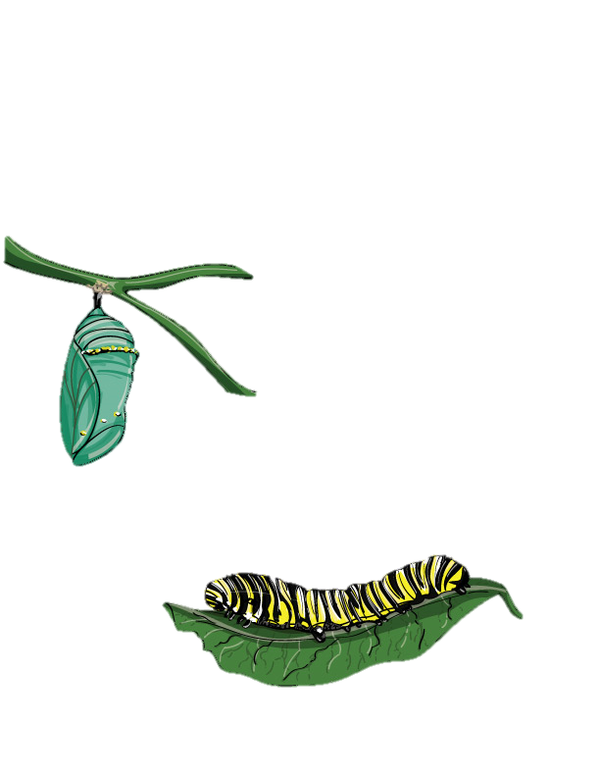
What are models?

Slide 11
Mathematical models
Using math to describe reality

Slide 12
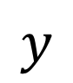
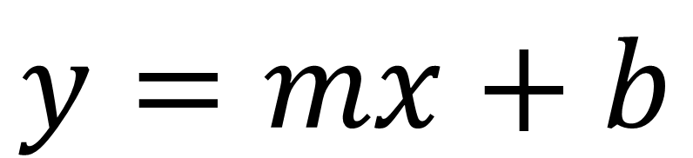
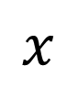
Mathematical models
$$y$$
$$x$$
$$y=mx+b$$

Slide 13
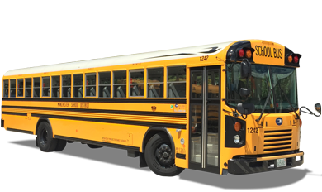
Uncertainty & statistics

Slide 14

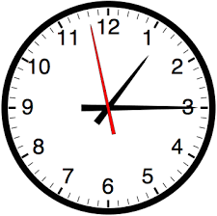
Models in ecology
How many individuals are there?
Where are these individuals located?
How is this population changing over time?

Slide 15
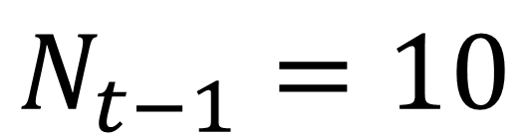
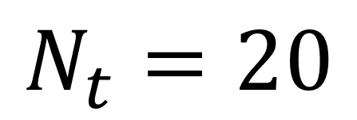
Population change
Population
Last Year
$$N_{t−1}=10$$
INCREASING!
Population
This Year
$$N_{t}=20$$

Slide 16
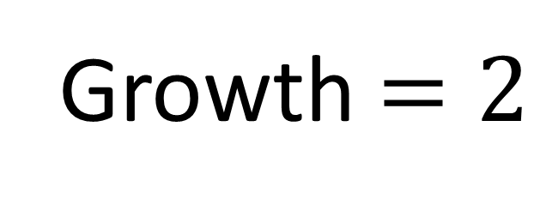
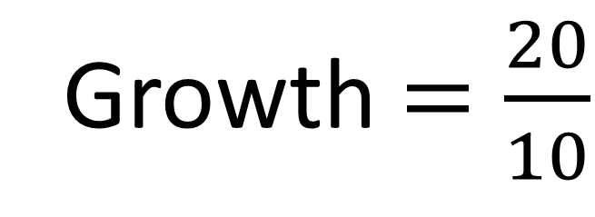
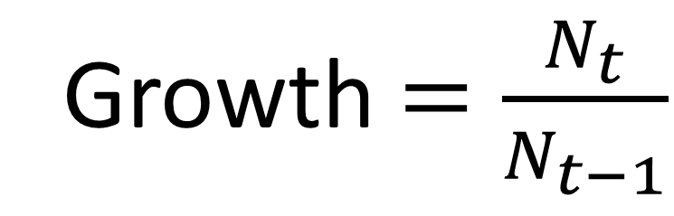
Population change
Growth $=\frac{N_{t}}{N_{t−1}}$
Growth $=\frac{20}{10}$
Growth $=2$

Slide 17
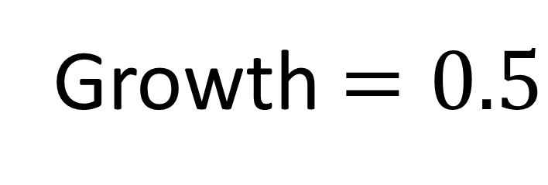
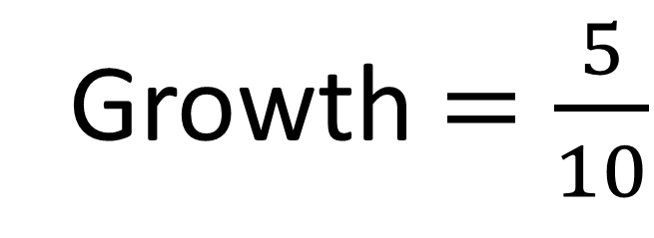
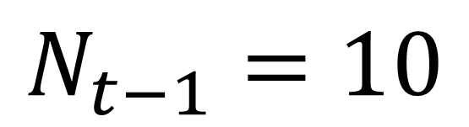
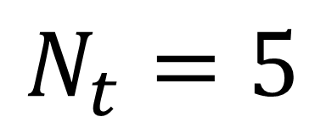
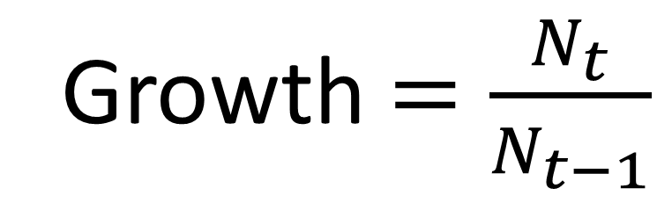
Population change
$$N_{t−1}=10$$
Growth $=\frac{N_{t}}{N_{t−1}}$
$$N_{t}=5$$
DECREASING!
Growth $=\frac{5}{10}$
Growth $=0.5$

Slide 18
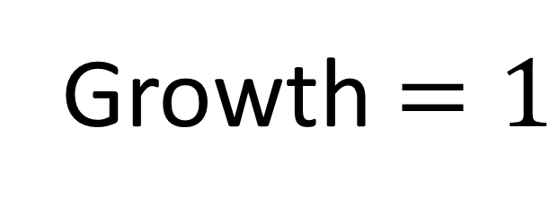
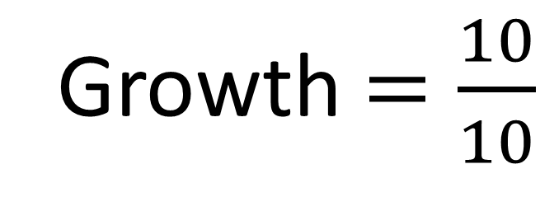
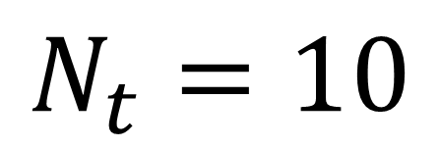
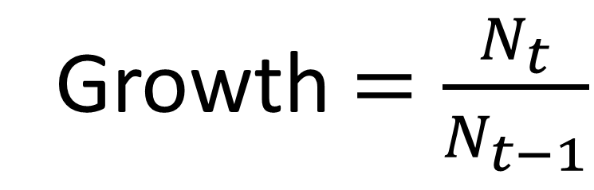
Population change
$$N_{t−1}=10$$
Growth $=\frac{N_{t}}{N_{t−1}}$
$$N_{t}=10$$
CONSTANT
Growth $=\frac{10}{10}$
Growth $=1$

Slide 19
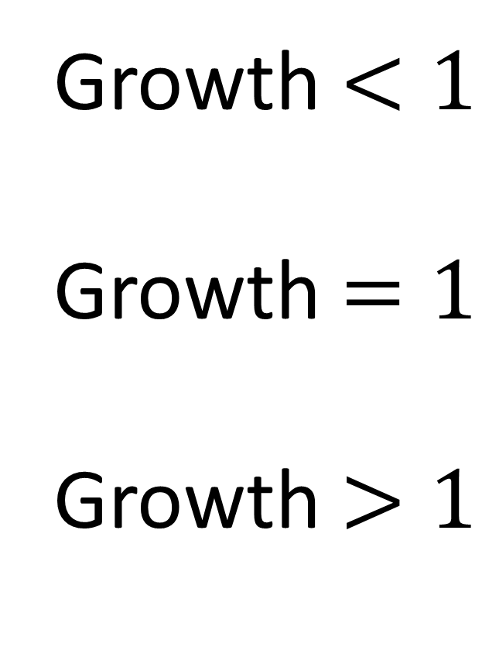
Population change
Growth $<1$
Growth $=1$
Growth $>1$
DECREASING
CONSTANT
INCREASING

Slide 20
Monarch module
Nectar plants
Winter forest habitat
Milkweed habitat
Climate change
Module Link:
https://danaus.shinyapps.io/Danaus/

Slide 21
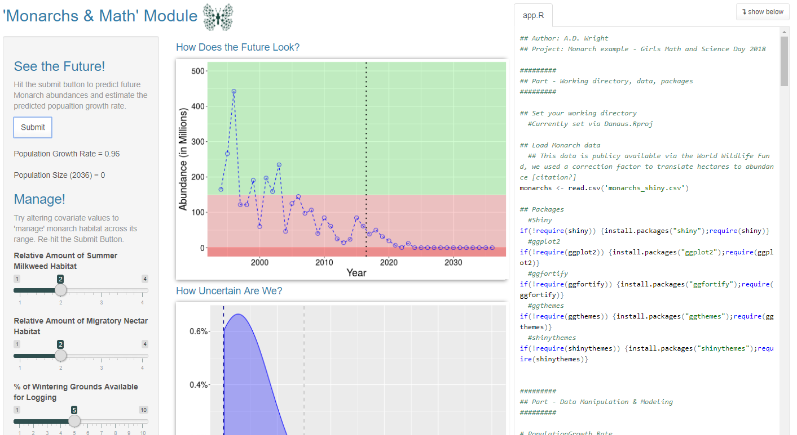
Monarch module
Run Module
Inputs
Outputs
Fill out the exercise sheet by interacting with the web app
Answer Q’s on the back!

Slide 22
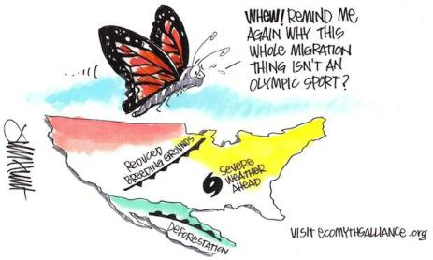

What can you do to help?
Make an area of your yard a monarch habitat!
Plant milkweed & nectar plants
Spread the word!

